Slide 1

Project 2.5 Prestige Car
By : ESO Group 1 Chengfu Qu

Slide 2
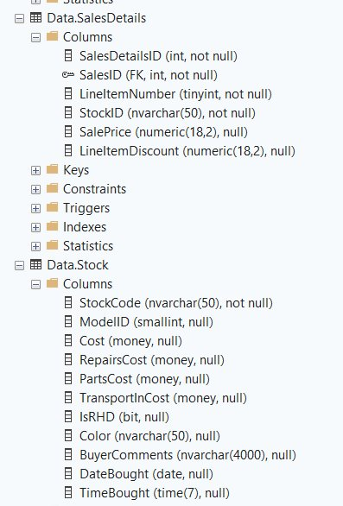
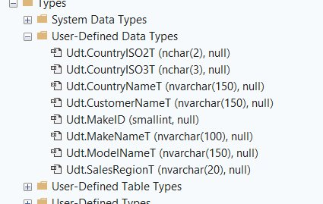
Creating User-Defined Datatypes
I have selected these Columns to be my User defined datatypes(UDT), because it holds references to another Tables. For example , the MakeID Column which has on Data.Make and Data.Model.
Since this is a Database based on Cars, All the User Defined DataType are relevant to a Car. I ignored other Columns like stock ID, Sales ID, SalesDetail ID because these revenue based.

Slide 3
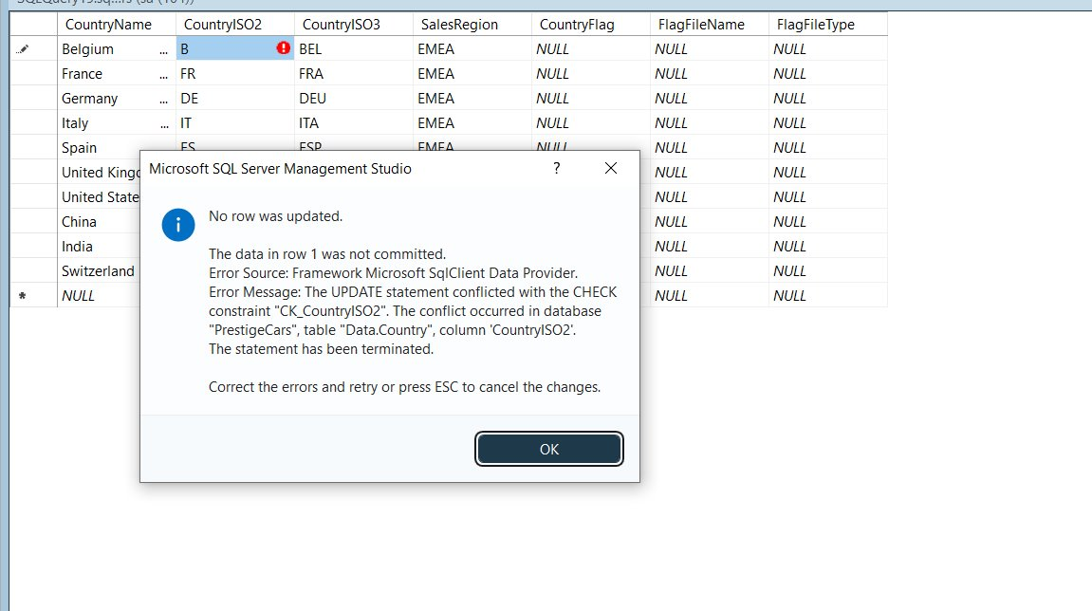

Slide 4
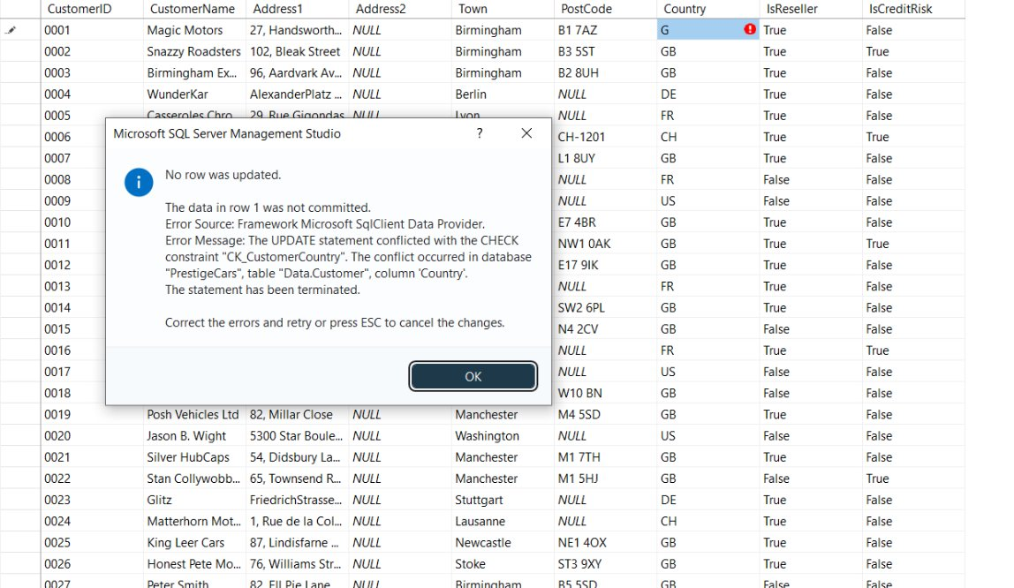
Add Constraints
I followed the video of Creating Constraints on CountryISO2 and CountryISO3 to create my own constraints.
For example
CustomerCountry

Slide 5
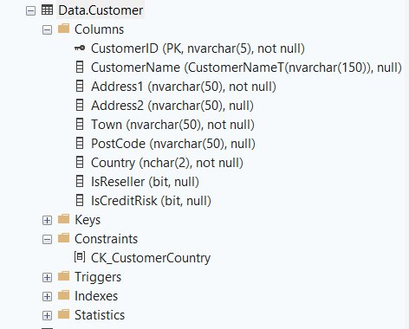

Slide 6
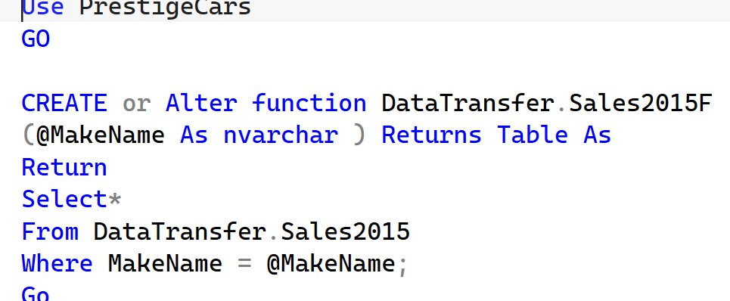
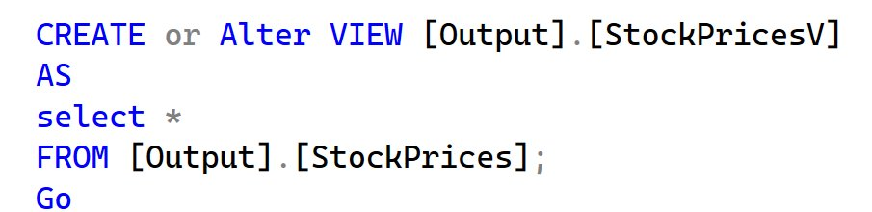
Views Or Inline Table Function
I did not use Redgate tools (i.e., SQL Prompt, SQL doc, SQL Compare, etc).
All I did was to import every to the View or Inline Table Function, with simple [Select*] and [From].

Slide 7
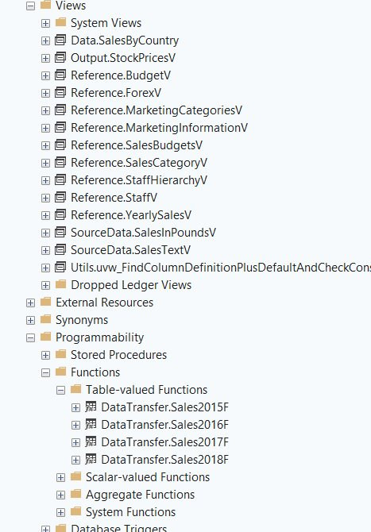
Views Or Inline Table Function
This is the result I created.

